Slide 1
FINITE ELEMENT ANALYSIS OF SPUR GEAR
Anish Ambhaikar (10BME1017)
Yash Ganatra (10BME1043)
Vivek Varia (10BME1109)

Slide 2
Objective
To do Finite Element analysis of a pair of spur gears in mesh.
To validate the results with that obtained from Lewis Bending theory.

Slide 3
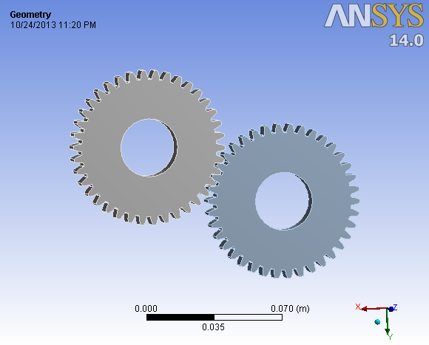
Design

Slide 4
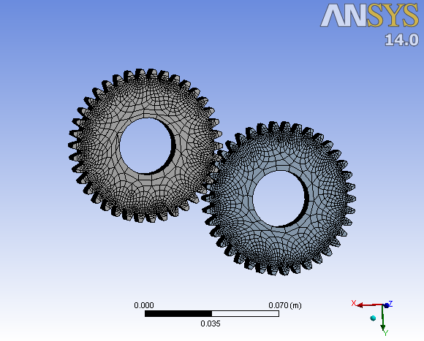
Meshing

Slide 5
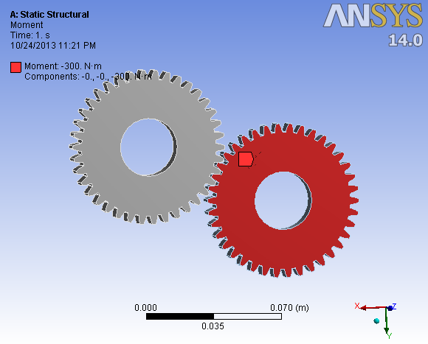
Constraints

Slide 6
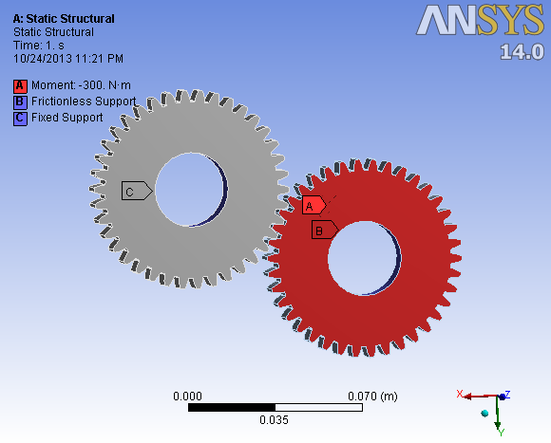
Constraints

Slide 7
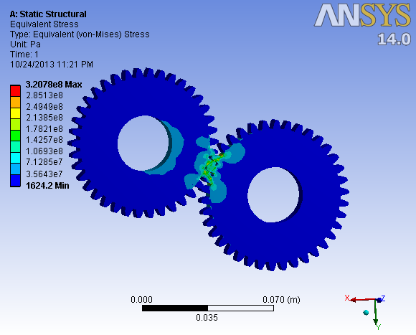
Von Misses Stress

